Slide 1
Chapter 2
1. Galton’s discovery of regression to the mean. Causality banished from statistics.
2. Sewel Wright and his guinea pigs labour in obscurity on it though
4. Path Analysis – combining qualitative knowledge on causes (the diagrams) with quantitative knowledge of associations (correlations in the data) and combining the two to estimate the magnitude of causal effects (the path coefficients on the diagram) – something you can’t do from the data alone.

Slide 2
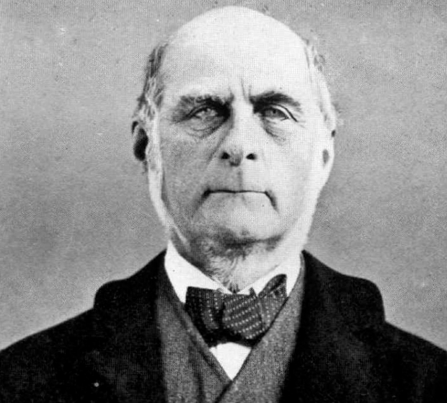
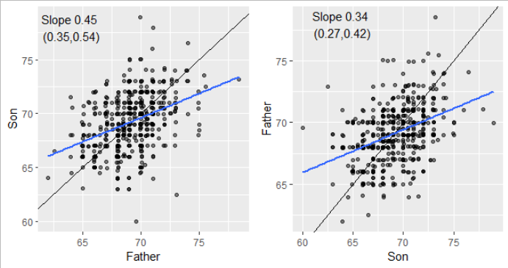
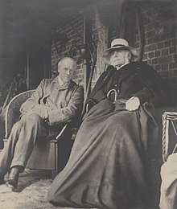

1. Galton’s discovery of regression to the mean
Wrong
Right
Is greatness inherited? ( I don’t have any data about that, so what about height then?)
Chance 1
Genes 1
Chance 1
Height 1
Height 1
Chance 2
Genes 2
Chance 2
Height 2
Height 2
Chance 2
Genes 3
Chance 2
Height 3
Height 3
 | Mean | SD
Fathers | 69.14 | 2.31
Sons | 69.23 | 2.62
r = 0.39
His “quincunx”
No more causality here!

Slide 3
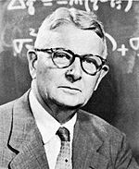
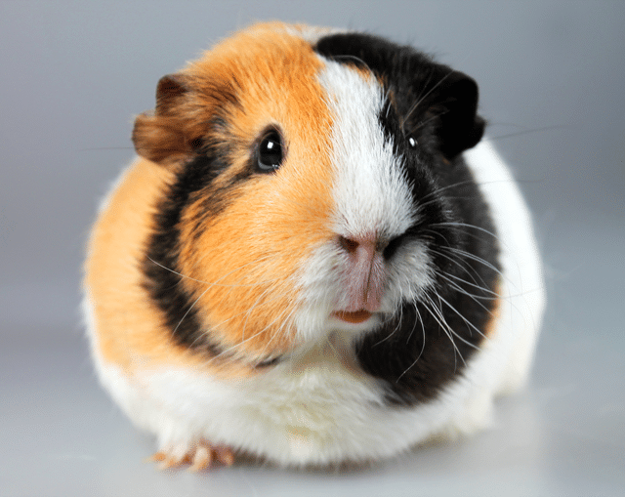
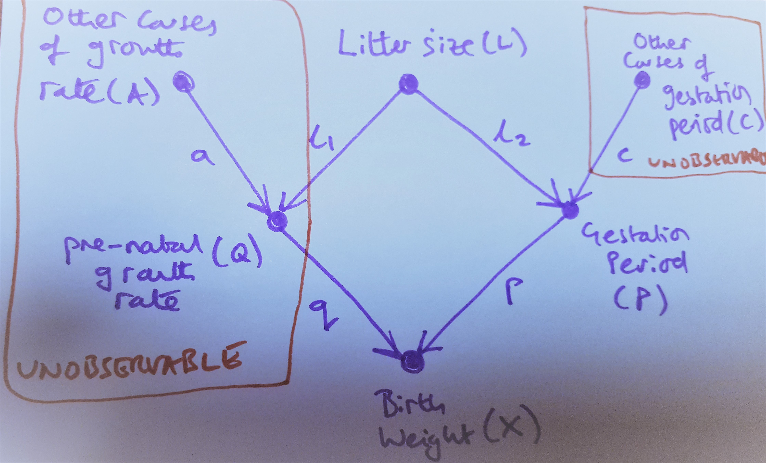
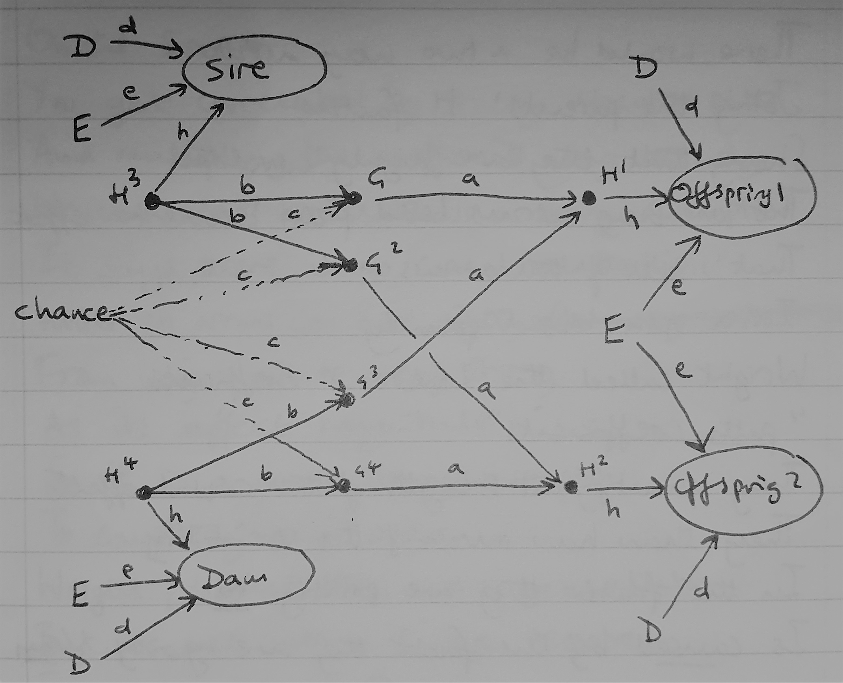
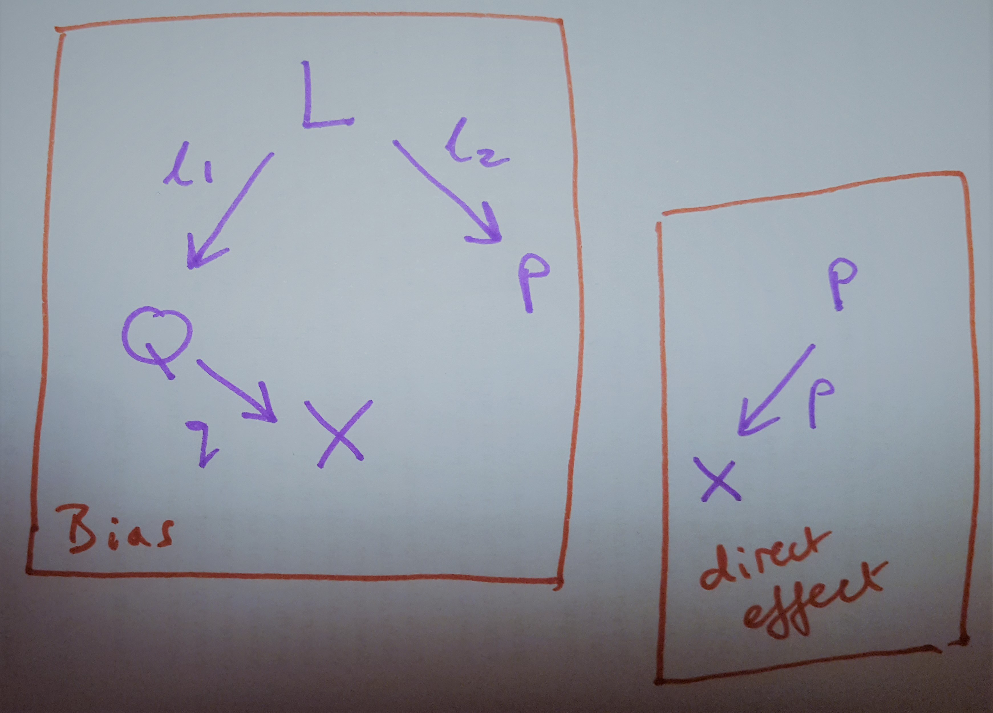
3. Sewel Wright and his guinea pigs labour on causality anyway
Magnitude of inherited vs environmental effects on coat colour
Estimating effect of extra day in womb on growth: you can’t just take the difference of birth weight at 66 days and 67 days

Slide 4
Chapter 3
1. Bayes rule – forward and backward probabilities.
We’re often interested in what effects say about causes, but questions and data are often presented the other way around – Bayes Theorem gives us a way to reverse this.
Where does the formula come from?
Confusing billiard table analogy.
2. Applying it to the breast cancer/mammogram problem.
3. So what is a Bayesian network?
Inspiration from the (non-artificial) neural network example of children learning to read
Directed acyclic graphs with forward probabilities and likelihood ratios on their arrows (depending on direction).
Arrows are not causal, just observational here.
Components of BNs – the three types of junction
Belief propagation
3.1 The baggage handling example
3.2 The Bonaparte example
4. From BN to causal inference – brining the notion of simulated experiment into the network. Details to be explained in subsequent chapters.

Slide 5
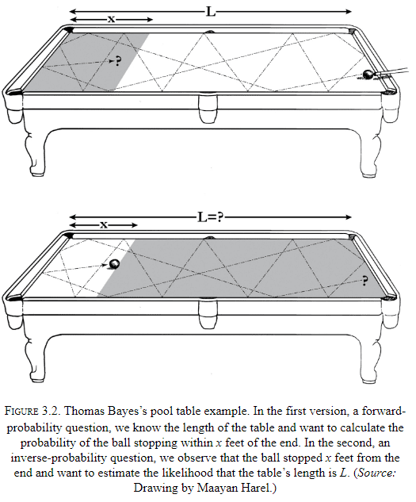
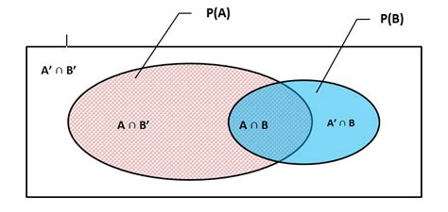
1. Bayes rule – forward and backward probabilities.
Something unlikely has happened. How much evidence do you need to believe in a given cause?
Formula derivations:
P(A and B) = P(A|B)*P(B)
P(A and B) = P(B|A)*P(A)
So P(B|A) = P(A|B)P(A)/P(B)
Likelihood ratio P(A|B)/P(B), prior P(A)
Why?
P(a|b) = P(a AND b)/p(b)
P(b|a) = P(a AND b)/p(a)
You can see this in the venn diagram

Slide 6
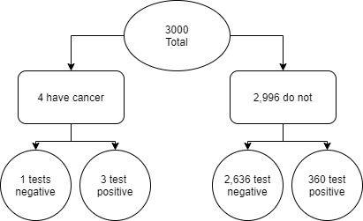
2. Applying it to the breast cancer/mammogram problem.
So, without a test, best guess is
P(D) ~ 0.14%
Updated belief with positive test for typical 40-yr-old
P(D|T) ~ 0.86%
Updated belief with positive test for high risk 40-yr-old
P(D|T) ~ 30.2%
T – positive mammogram
D – probability of having breast cancer
Given some population data:
P(T|D) = 73% (test sensitivity) 0.7300
P(D) for typical 40-yr-old = 1/700 (prior) ~ 0.0014
P(D) for high risk 40-yr-old = 1/20 (prior) = 0.0500
P(T) = P(T|D)*1/700 + P(T|not D)*699/700 ~ 0.1209
Likelihood ratio = P(T|D)/P(T) ~ 6.0380
Typically, talk about the forward prob P(T|D)
But more likely interested in the posterior prob P(D|T)

Slide 7
3. So what is a Bayesian network?
Levels of the network:
Actual input
Features (lines and curves)
Letters
Letter clusters
Lexical level (words)
Syntactic level (grammar etc)
Semantic level (context and meanings)
Input passes up, down, sideways, guesses at input interpretation converging with iteration
Inspiration for BN’s – the child reading neural network
Components of a BN – 3 junctions, belief propagation
Mediator A -> B -> C
Fire alarm
Fork (Confounder) A <- B -> C
Shoe size and reading ability
Collider A -> B <- C
Talent, beauty, and celebrity

Slide 8
3.1 Baggage example
3.2 Bonaparte example
Bag on plane
Elapsed time
Identifying crash victims from DNA
Where do they fit into family tree?
DNA available from them, and from some non-direct relatives
Given a sample, plus some non-genetic information, what is the chance that this victim got their eye colour allele from this person?
Observed genotype, unobserved alleles, incomplete information.
Decisions made during the belief propagation process inform subsequent decisions
Bag will appear
P(bag will appear|not seen yet) =
P(not seen yet|bag will appear)*
P(bag will appear)/
P(not seen yet)
Prob |  | Won't appear this minute | Will Appear this minute
Bag on plane | Time elapsed
FALSE | 0 | 100 | 0
FALSE | 1 | 100 | 0
FALSE | 2 | 100 | 0
… | … | … | …
TRUE | 0 | 100 | 0
TRUE | 1 | 90 | 10
TRUE | 2 | 80 | 20
… | … | … | …
At one minutes this is
P(B|NS) = LR* P(B)
=(0.9/0.95)*0.5

Slide 9
4. From BN to causal inference – brining the notion of simulated experiment into the network. Details to be explained in subsequent chapters.

